Slide 1
“Ten Seeds” How mobiles have contributed to growth and development in women-led farming cooperatives in Lesotho
Katharine Vincent and Tracy Cull
M4D2010: Mobile Communication Technology for Development
Protea Hotel, Kampala
10-11th November 2010
Notes:
1

Slide 2
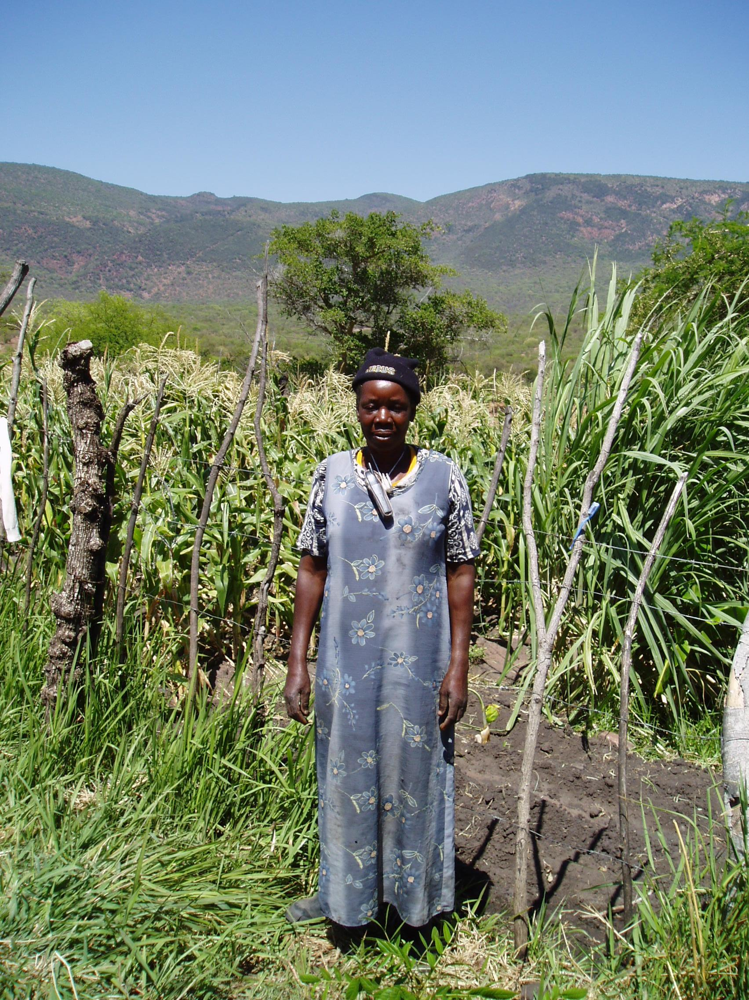
South Africa, photo by K. Vincent (2004)
Notes:
Increasing cellphone penetration
Over 246 million mobile subscriptions at the end of 2008, out of a population of just under 700 million
Rate of growth between 2003 and 2008 was more than double the rest of the world
In 2008 58.5% of the population was covered by a cellphone signal (100% of inhabited areas in SA, Botswana, Mauritius and the Seychelles).
South Africa, Kenya and Uganda oblige cellphone operators to provide non-urban coverage as part of their licence agreements

Slide 3
Summary
(How) do mobiles contribute to development?
Theories of development
Development as economic growth
Development as choice
Development as empowerment
Case study from Lesotho with 4 years of qualitative evaluations (unique longitudinal perspective)
Utility of qualitative and longitudinal evaluations

Slide 4
RHVP’s Distribution of Cellphones in Lesotho
10 cell phones distributed amongst members of the women-led Thulare Dairy Farmers Cooperative in different agro-ecological zones in Lesotho
1 to a lowlands cooperative group
4 to foothills cooperative groups
5 to highlands cooperative groups
Intention was “to support remotely-located rural people and to connect them with markets, primarily” (Chaka Ntsane, RHVP Country Coordinator for Lesotho)

Slide 5
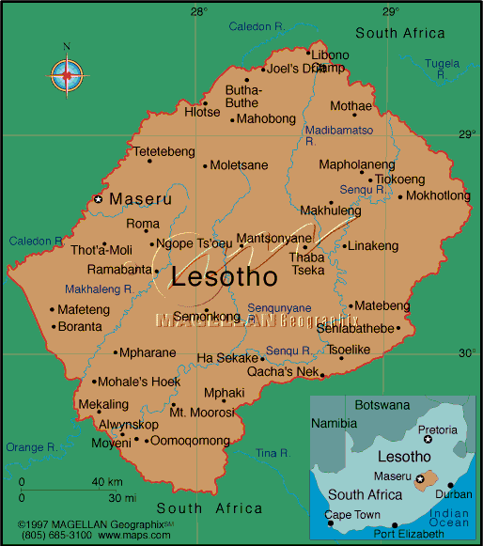

Slide 7
Mobiles and Economic Growth
1. Growth and expansion of existing activities:
Reduced transactional costs
Easier to organise meetings (previously required entrusting a taxi driver with a letter, or physically delivering it – up to 200km between groups, costing ZAR130 (approx US$18) and taking 8 hours each way)
increased sales
Coordination of input to shows (many trophies)
Swapping within the cooperative (wheat from the highlands for maize from the lowlands in 2010)

Slide 8
Mobiles and Economic Growth (cont’d)
2. Transformation:
Selling airtime (from 10 to 27 cooperative-owned handsets)
New agricultural activities (breeding Duroc pigs in the lowlands)
Selling clothes (particularly in the foothills – at some distance from Maseru)
Tourism-based businesses funded by loaning out profits in the highlands (Semonkong)

Slide 9
Mobiles and Empowerment
Empowerment is difficult to quantify and thus often overlooked
“We were so proud, as women, to receive these cellphones” (lowlands)
Learning English and mathematical literacy (highlands)
“we want to buy more mobiles in order to stay united” and “we are vulnerable – to be strong we need to be able to communicate” (lowlands)
Access to governance and formal networks (e.g. Ministry of Agriculture, Ministry of Trade and Industry, Cooperatives and Marketing)
Access to training opportunities (particularly in South Africa)
Notes:
But the benefit of repeated qualitative evaluation is that empowerment-related benefits came out.
There is a Basotho saying that “if you walk alone you are doomed” – importance of collective action in society.

Slide 10
Mobiles and Choice
“We turned mobiles into a business” – Manager of Thulare Dairy Farmers’ Cooperative
Range of choices available to cooperative members has grown over the past 4 years
Next choices
Prepaid wireless telephones (reduced calling cost)
Savings and Credit Association (available to cooperative member groups and individuals within those groups)
Notes:
The range of choice is incorporated into the previous two: growth and empowerment. They were able to accomplish those because they had better choice.
Savings and Credit Scheme - financed by each of the six member groups paying ZAR200 per annum to the cooperative (which is added to the account which holds their ZAR500 once off membership fee).
20% of the total funds must remain in the bank while 80% of the funds should be loaned out to members of member groups at a rate of 2.5% per month.
Each member of a member group is entitled to use the cooperative as a savings scheme with interest of 1.5%
At the July 2010 follow up evaluation meeting ZAR680 was invested by individual members, highlighting the trust in, and support for, the initiative. The cooperative foresees employing a permanent “teller” to handle transactions in the future.

Slide 11
Conclusion
Definite evidence for the positive developmental impacts of mobiles in this case study in Lesotho, whether development is defined as:
Economic growth
Empowerment
Choice
Suggests a need to rethink how developmental impacts are evaluated
Longer-term approach (beyond duration of the project)
Including qualitative experiences

Slide 12
www.wahenga.net
rhvp@rhvp.org
Notes:
12

